Slide 1


Slide 2
Revision going to a school fair

Slide 3



Slide 4
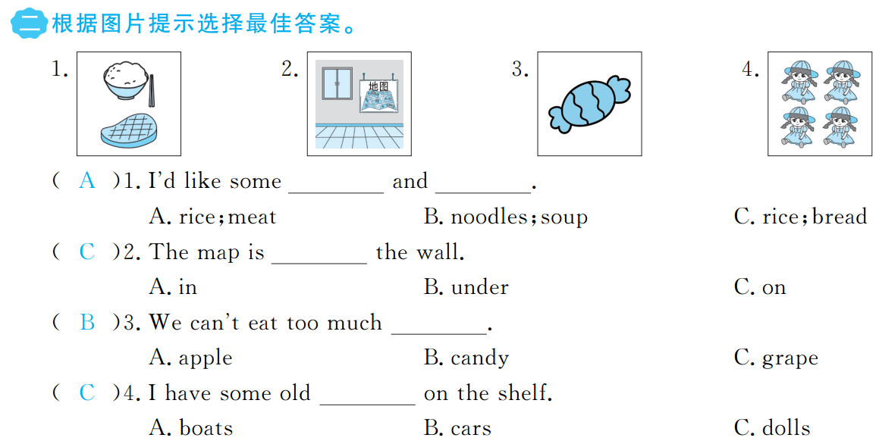

Slide 5
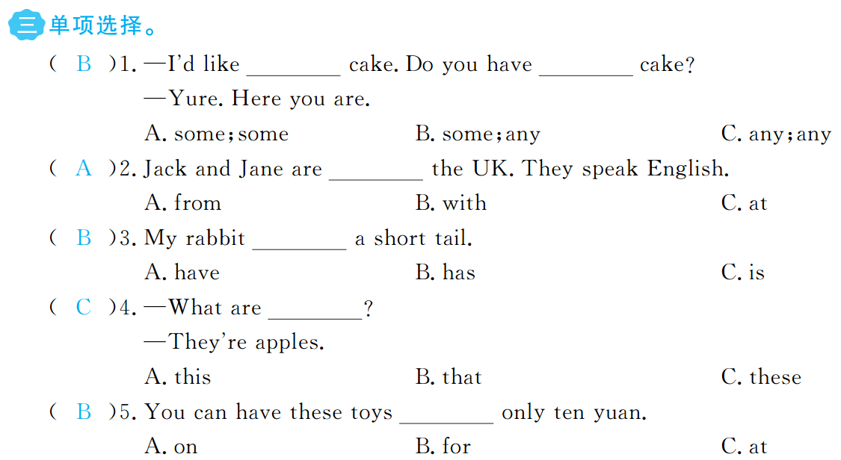

Slide 6



Slide 7
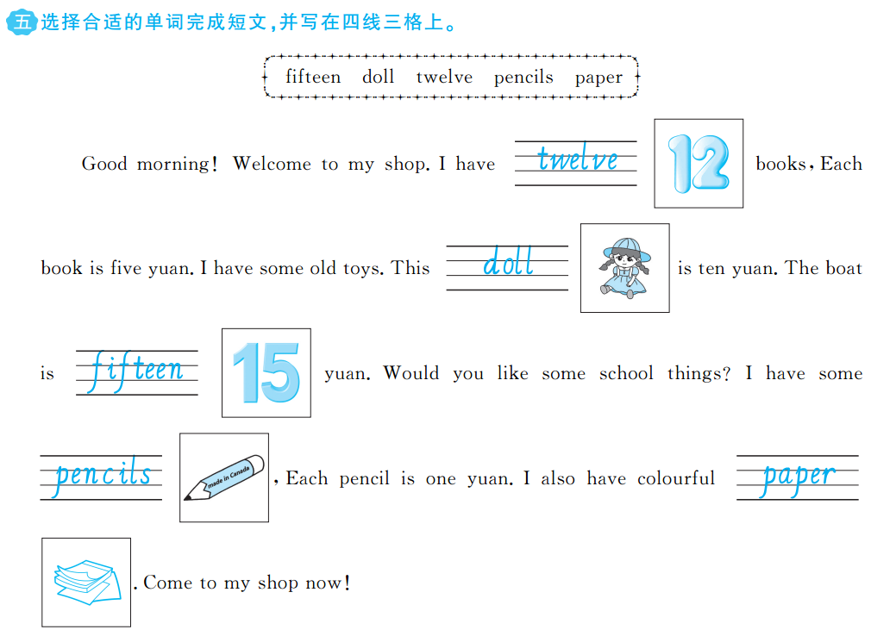


Slide 8
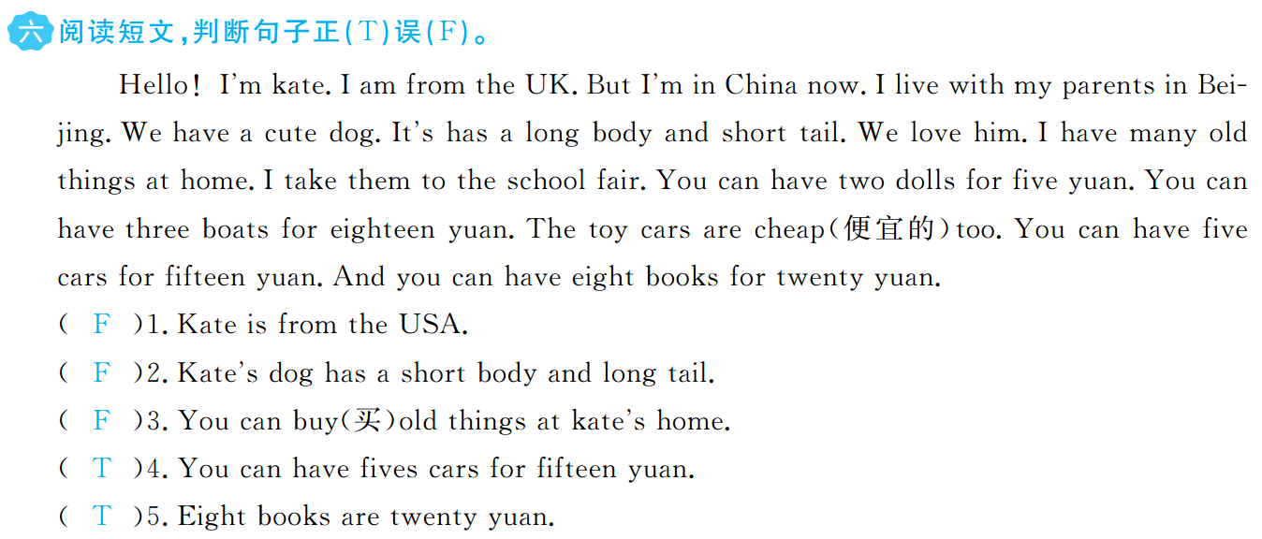

Slide 9


