Slide 1


Slide 2
Unit6 Numbers in life
第六课时 B Read and write

Slide 3
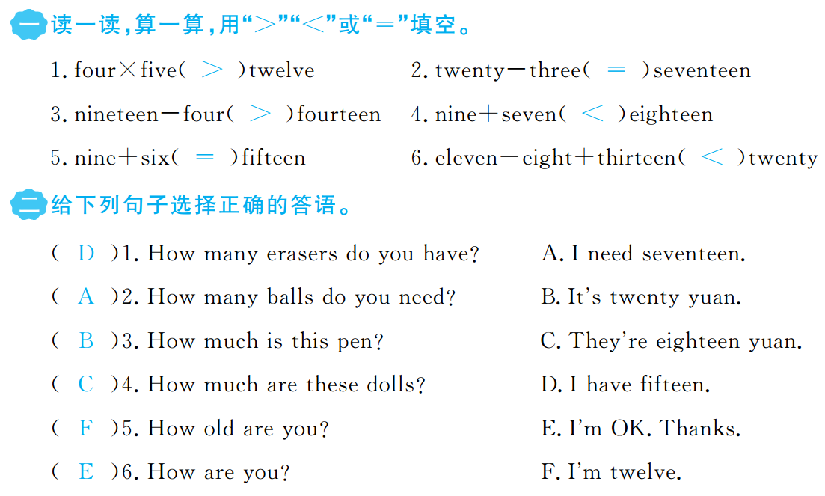


Slide 4
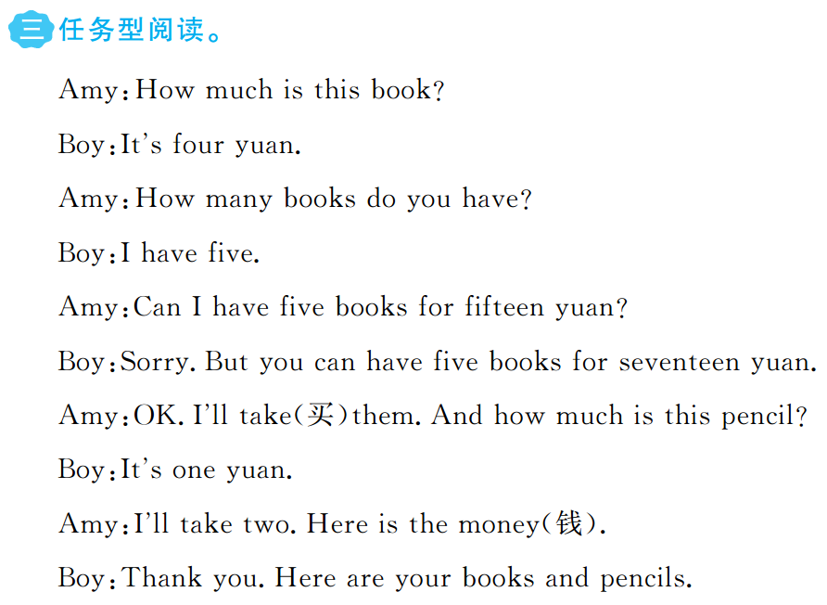

Slide 5
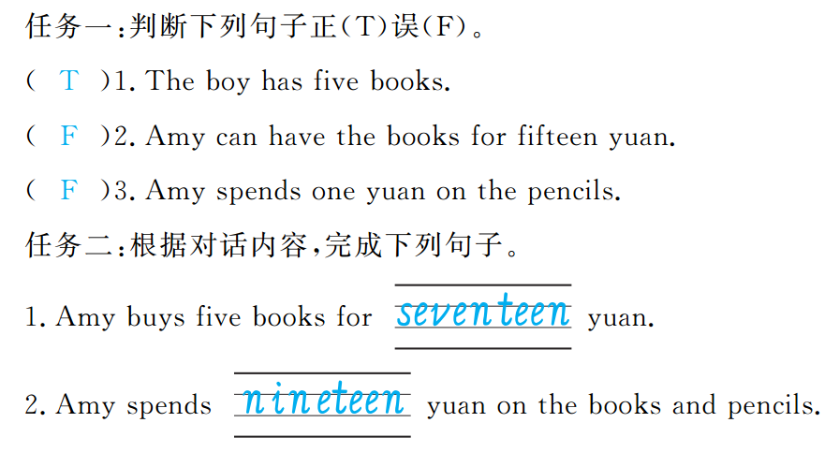


Slide 6


