Slide 2
Unit6 Numbers in life
第一课时 A How do numbers help us count？
Let’s talk & count and say

Slide 3
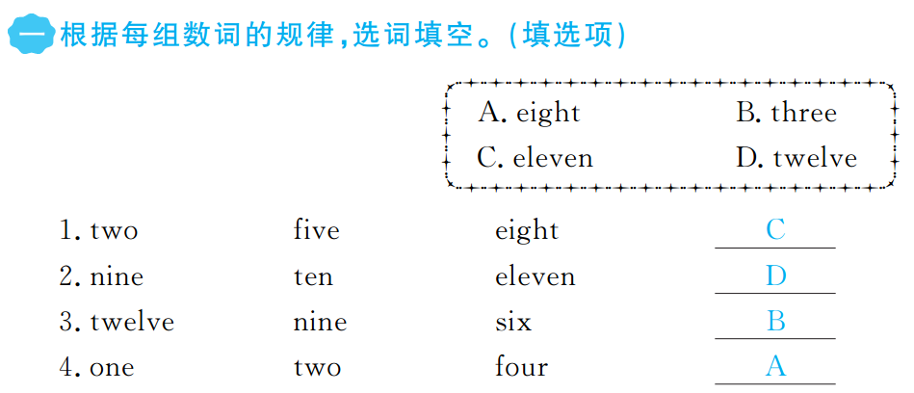

Slide 4
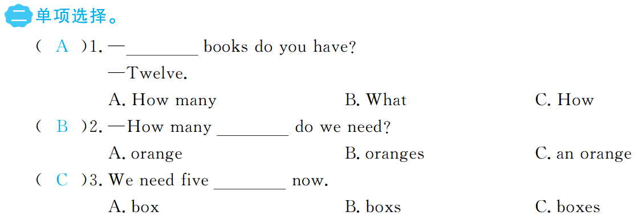

Slide 5
