Slide 1


Slide 2
Unit3 learning better
第一课时 A What tools help
us learn?
Let’s talk & Ask and answer

Slide 3
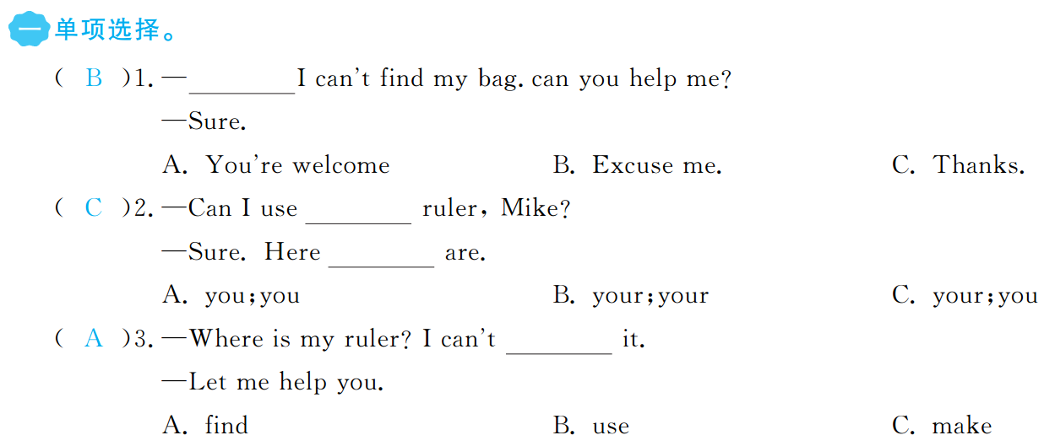


Slide 4
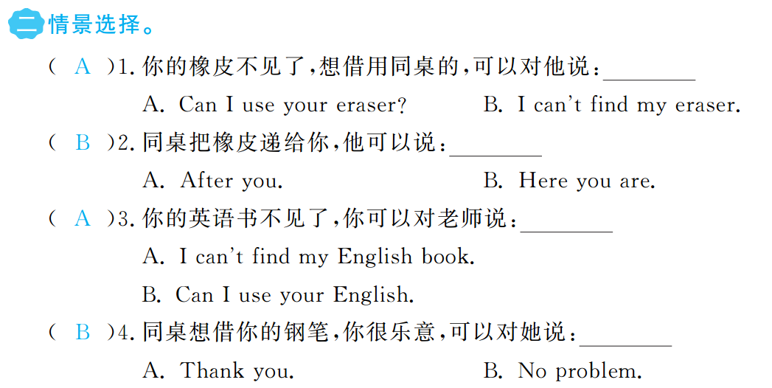

Slide 5
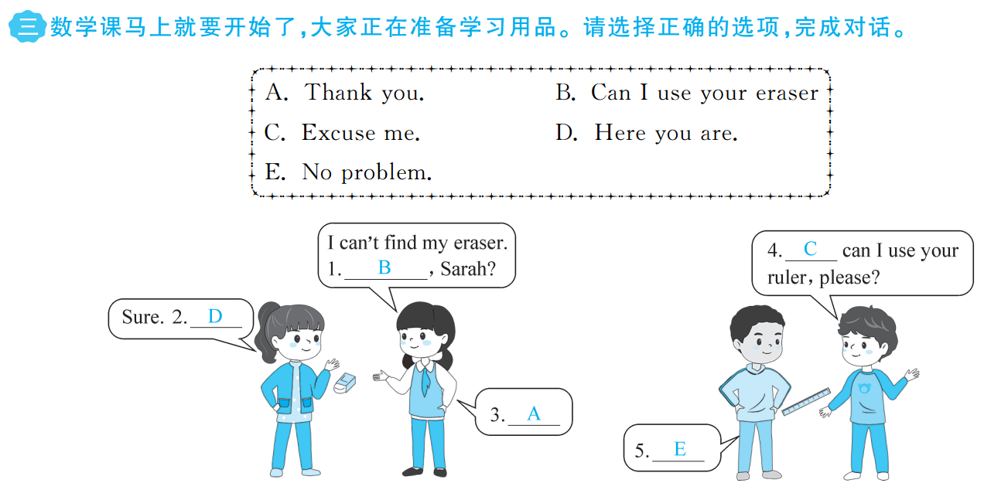

Slide 6


