Slide 1


Slide 2
Unit1 Meeting new people
第六课时 B Read and write

Slide 3
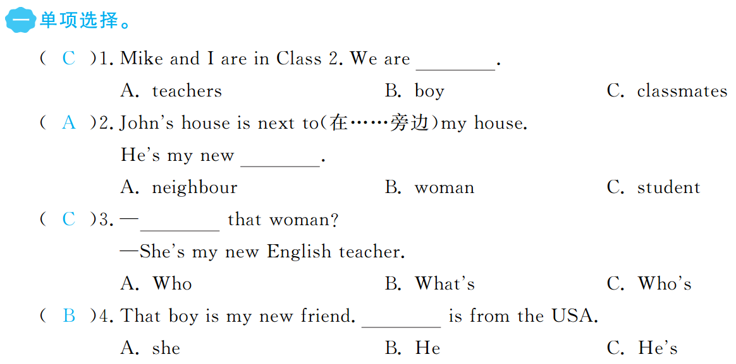


Slide 4
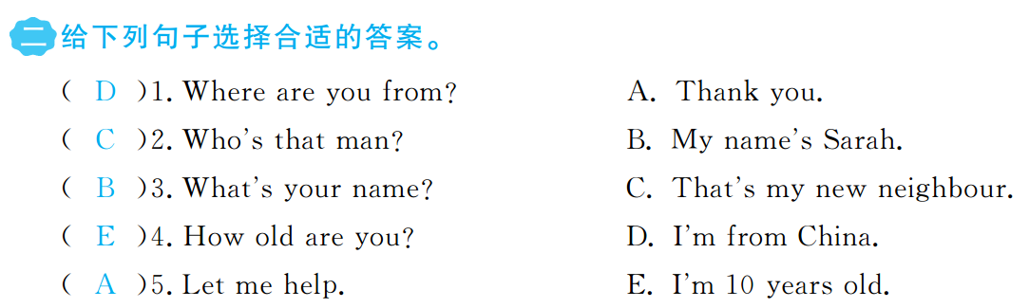

Slide 5
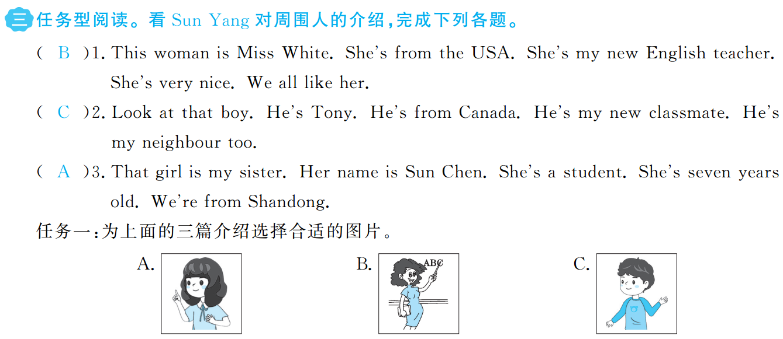

Slide 6
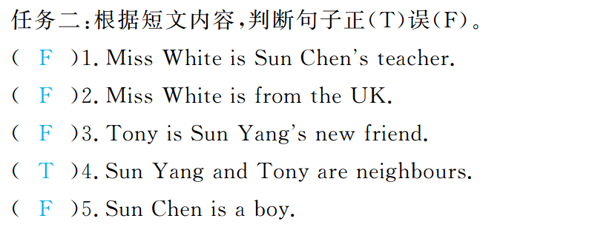

Slide 7


