Slide 2
Unit1 Meeting new people
第一课时 A How do we greet new people?
Let’s talk & Do a survey

Slide 3
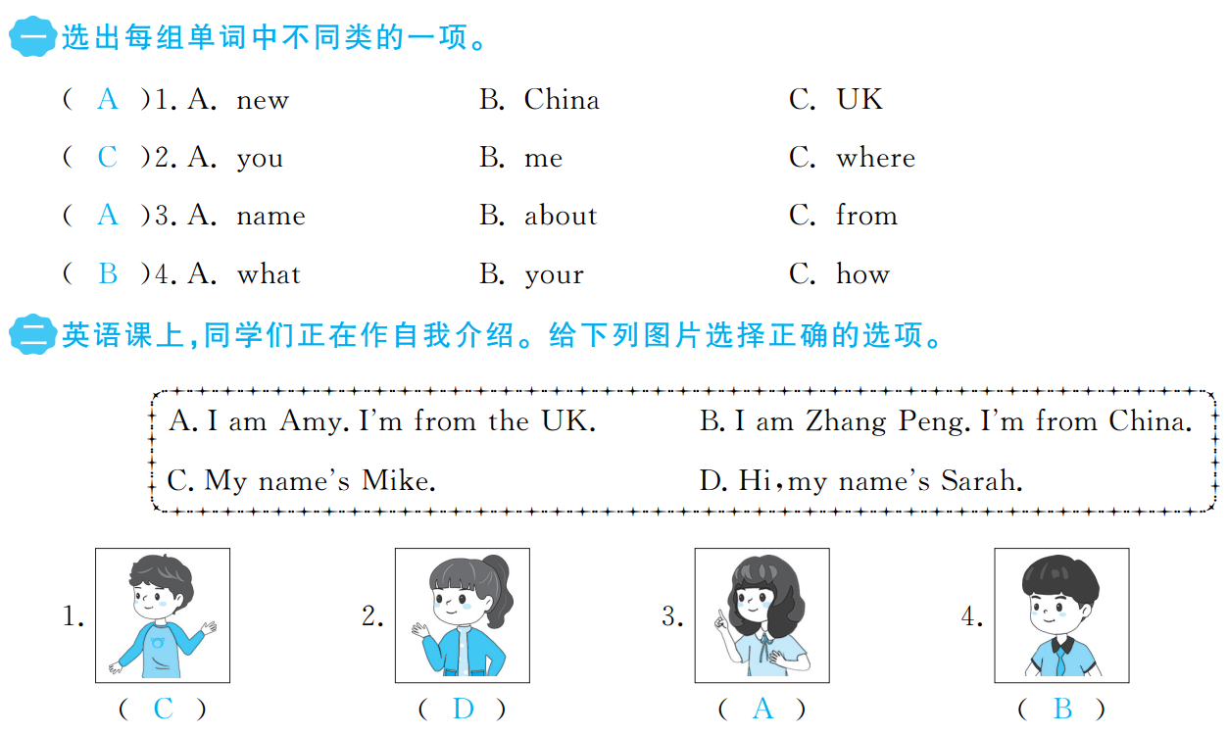

Slide 4
