Slide 2



Slide 3
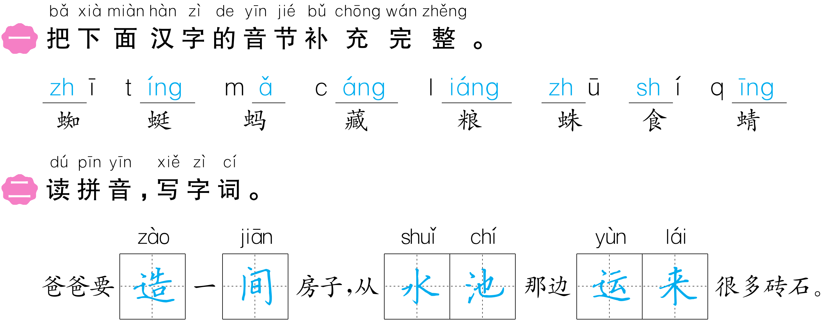

Slide 4


Slide 5

0

Slide 6
